Slide 1
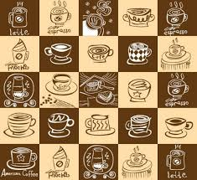
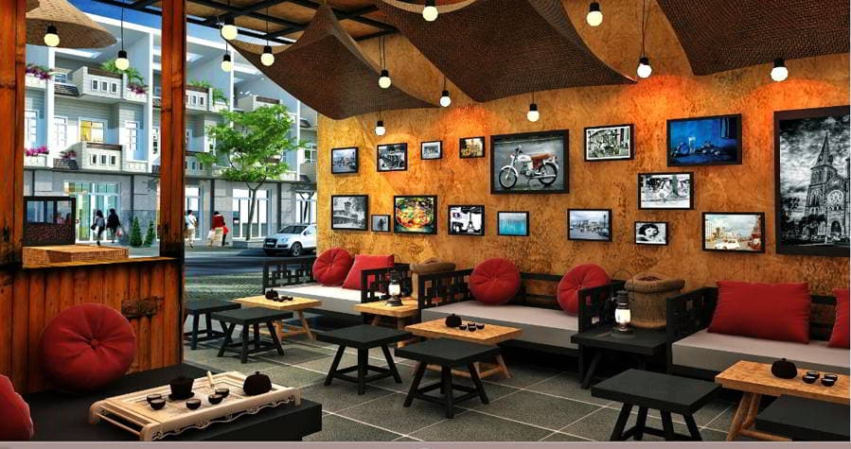
Huong Viet coffee shop

Slide 2
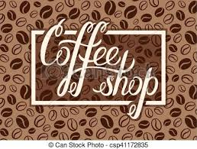
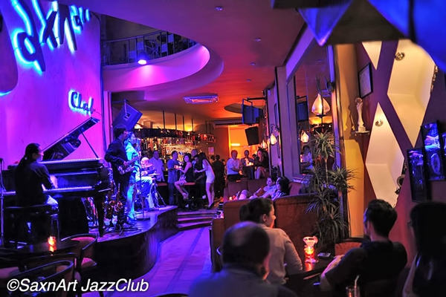
Huong Viet coffee shop

Slide 3

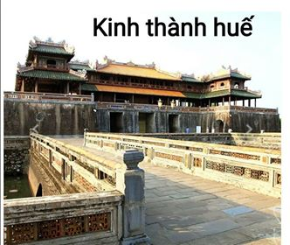
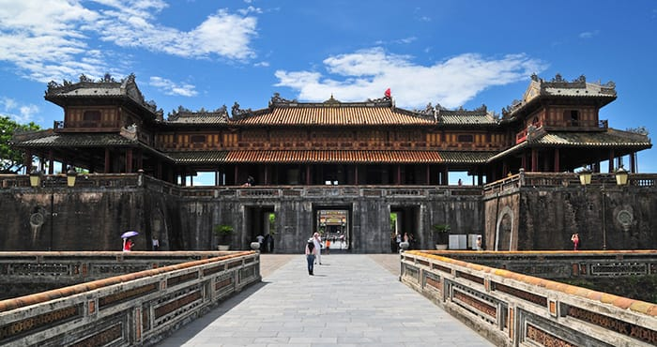
Located on the banks of Huong river,
The capital of Thua Thien Hue province in central Viet Nam.
Historic values
Recognized as one of the World Heritage Sites by UNESCO.

Slide 4

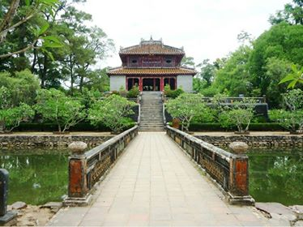
Minh Mang Tomb
- located on the west bank of Perfume River
- 12km south of Hue City center.

Slide 5

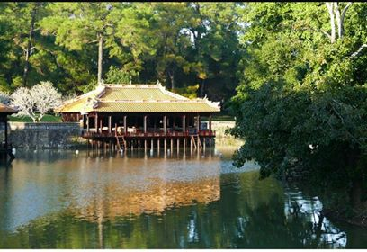
Tu Duc Tomb

Slide 6

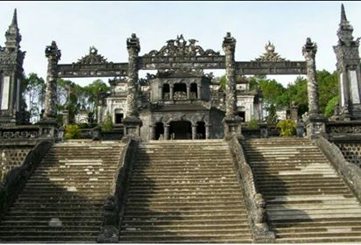
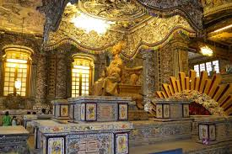
Khai Dinh Tomb
the most surprising royal tomb in Hue

Slide 7


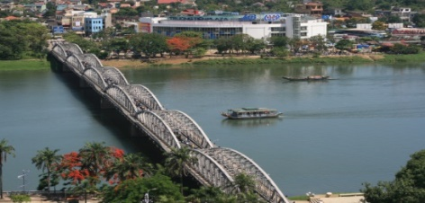
Truong Tien Bridge is one of the first bridges in Hue crossing Perfume River,
This is one of the typical symbols in Hue

Slide 8

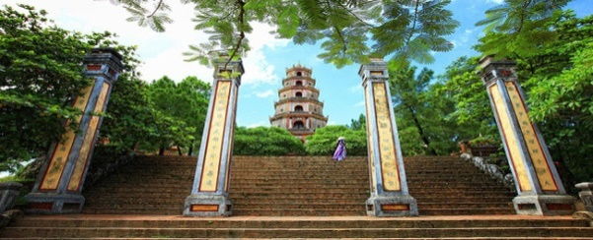
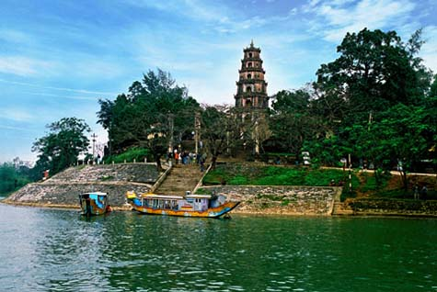
Thien Mu Pagoda
- Called sacred place
the symbol of the octagonal
21 meter-high tower
The combination of artificial architectural work and picturesque nature.

Slide 9
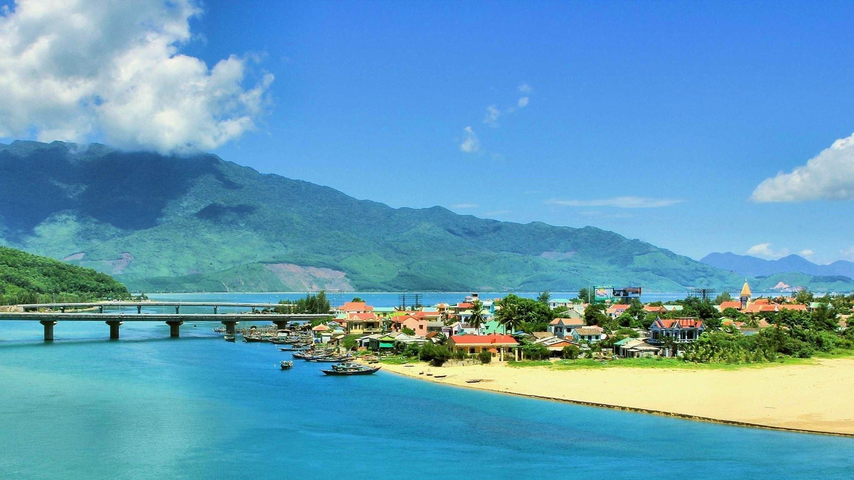
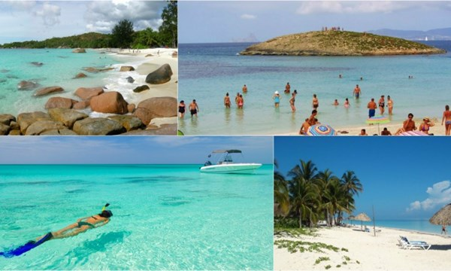
Lang Co Beach
Lang Co is
among the most
wonderful beach in Hue

Slide 10

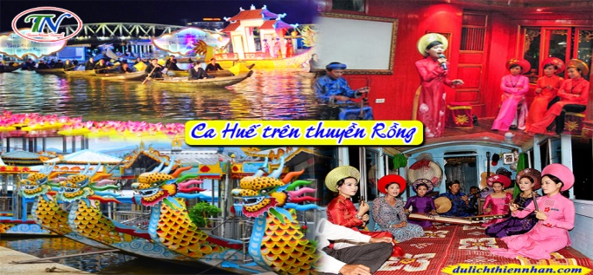
Dragon Boat
Enjoying the landscape
and watching
Royal Art Performance

Slide 11
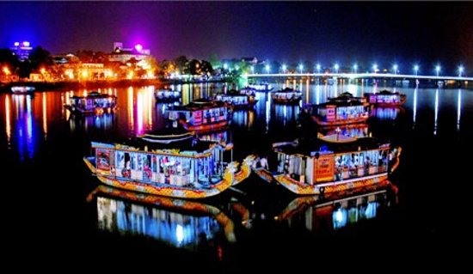
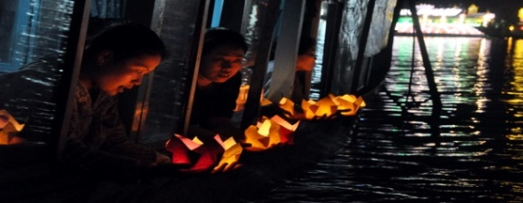
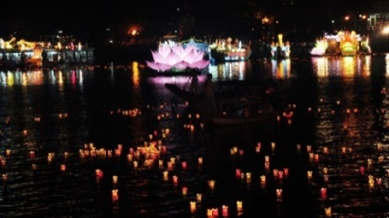
Drop down flower to Huong River enjoy beauty of Hue at night.

Slide 12

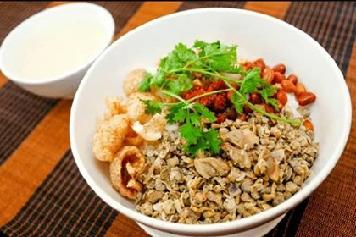
Com Hen
rice with baby clams a very simple and low priced specialty.

Slide 13
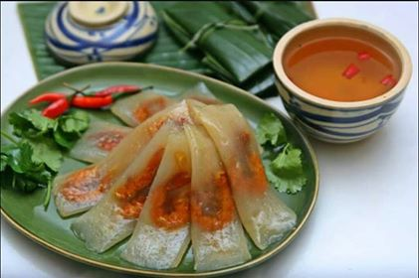
Banh Bot Loc
rice pastry with meat and shrimp

Slide 14
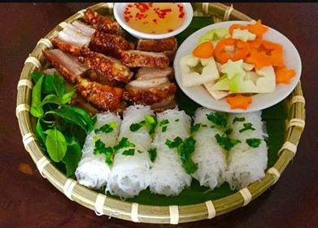
Banh Hoi Thit Quay
roast pork pastry

Slide 15
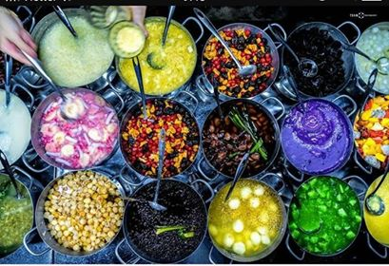
Che Hue ( sweet soups)
there are nearly 50 kinds of Che.

Slide 16
Group 2 : Talking about a plan for Hue trip.

Slide 17
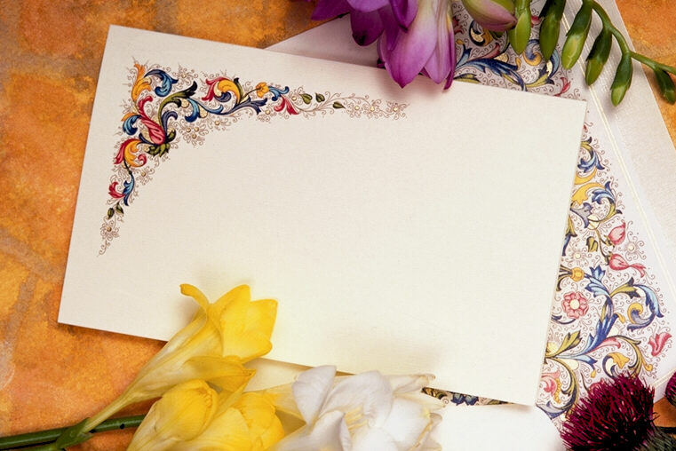
Small game
“Follow pictures to answer the questions”

Slide 18
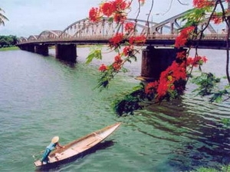
1. What is the famous river and bridge in Hue?
Perfume River, Truong Tien bridge

Slide 19
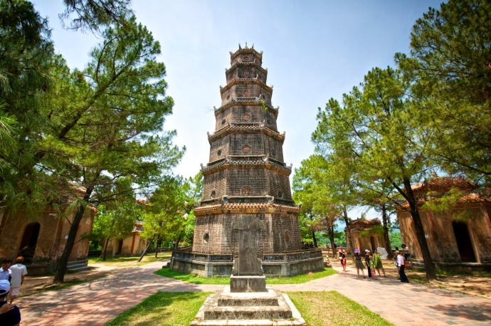
2. What is the famous pagoda in Hue?
Thien Mu pogada

Slide 20
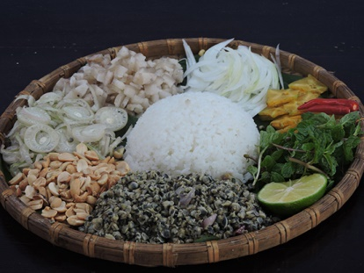
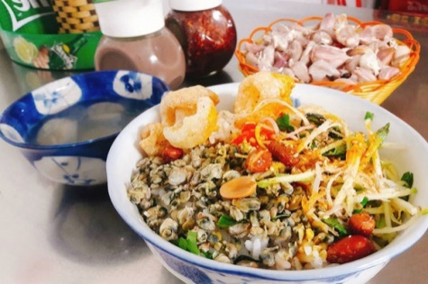
3. What is the famous food in Hue ?
Com Hen

Slide 21
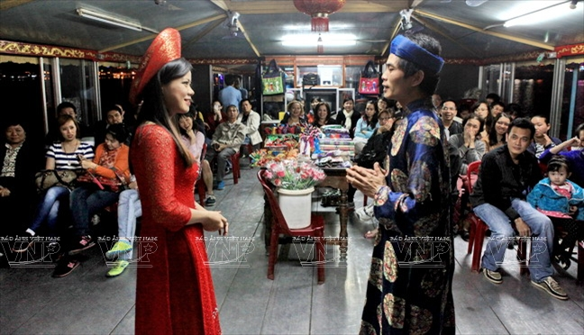
4. What is the program?
Royal Art Performance

Slide 22
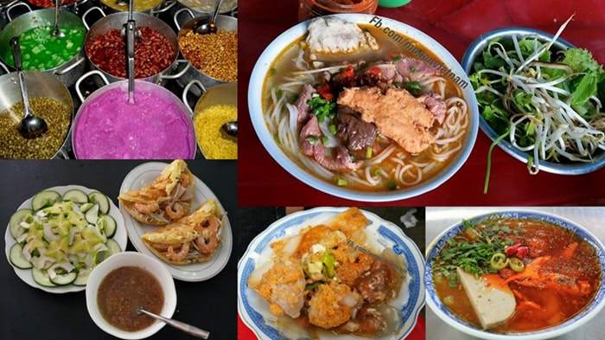

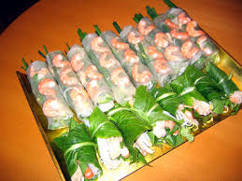
5. What thing do you like best in Hue? Why ?
I like the food best in Hue because it is very delicious.

Slide 23



